Slide 1
Function (2)

Slide 2
Objectives
This chapter introduces:
Arguments & parameters
Immutable and mutable objects
Return data in a function
Call the function

Slide 3

Arguments & parameters
A parameter is the variable listed inside the parentheses in the function definition
You can add as many parameters as you want, just separate them with a comma
An argument is the value that is sent to the function when it is called
Information can be passed into functions as arguments
def person(name, age, gender):
print('Name: ' + name, end = ', ')
print('age: ' + str(age), end = ', ')
print('gender: ' + gender)
person('John', 25, 'Male')
person('Sandy', 32, 'Female')

Slide 4
Default parameter value
The parameters of a function can use default values
If we call a function without argument, it can use the default value
def person(name = 'Andy', age = 18, gender = 'Male'):
print('Name: ' + name, end = ', ')
print('age: ' + str(age), end = ', ')
print('gender: ' + gender)
person() # Name: Andy, age: 18, gender: Male
person('John', 25, 'Male') # Name: John, age: 25, gender: Male

Slide 5

Default parameter value
def person(name = 'Andy', age = 18, gender = 'Male'):
print('Name: ' + name, end = ', ')
print('age: ' + str(age), end = ', ')
print('gender: ' + gender)
person()
person('Bob')
person('Maria', 'Female')
# The arguments will be carried into the function in order
person('Maria', gender = 'Female')
# Parameter can be specified when calling the function

Slide 6
Immutable and mutable objects
There are two kinds of objects in Python
Mutable Object
list, dict, set, byte array, user-defined classes
The value of a mutable object can be modified in place after it’s creation
Immutable Object
int, float, long, complex, string tuple, bool
The value of an immutable object cannot be changed
When we attempt to modify an immutable object, Python simply gives us a different object instead

Slide 7
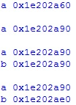
Immutable objects
a = 5
#id(obj): Get the memory address
print(‘a ’ + hex(id(a)))
print()
a += 3
print('a ' + hex(id(a)))
print()
b = a
print('a ' + hex(id(b)))
print('b ' + hex(id(b)))
print()
b += 5
print('a ' + hex(id(a)))
print('b ' + hex(id(b)))
Output result:
a += 3: a’s address is changed
b = a: the addresses of a and b are the same
b += 5: the address of b is changed

Slide 8
Mutable objects
The value of a mutable object can be directly modified
After the value is modified, the memory address of the object will be the same as before
If two variables refer to the same mutable object through a process called aliasing (assign one variable the value of the other variable)
The value of one variable is changed as well as that of the other variable

Slide 9

Mutable objects
a = [0, 0]
b = a
print('a ' + hex(id(a)))
print('b ' + hex(id(b)))
print()
b[0] += 1
b.append(2)
print('a ' + hex(id(a)))
print('b ' + hex(id(b)))
print()
print(a)
print(b)
Have the same address after changing the value,
The values of a and b are the same

Slide 10

Immutable and mutable objects
Argument of a function can be an immutable object or a mutable object
def add_number(num):
num += 1
print(num)
a = 0
add_number(a)
print(a)
def add_number(num):
num[0] += 1
print(num[0], num[1])
b = [0, 0]
add_number(b)
print(b[0], b[1])

Slide 11
Return data
Use the return keyword in the function to return the result of the function
def add(a, b ,c):
d = a+b+c
return d
print(add(3, 4, 14))
# add(3, 4, 14) = 21
# print(add(3, 4, 14)) = print(21)

Slide 12
Call a function
In a function, it allows to call itself or another function
Recursive function
A defined function can call itself
Recursion is a common mathematical and programming concept
The developer should be very careful with recursion as it can be quite easy to slip into writing a function which never terminates, or one that uses excess amounts of memory or processor power
When written correctly recursion can be a very efficient and mathematically-elegant approach to programming

Slide 13
Example
def max2(a, b):
if(a > b):
return a
else:
return b
def max3(a, b, c): # Find the largest one of the three numbers
d = max2(a, b) # Call another function
return max2(c, d)
print(max2(5,3))
print(max3(20,15,36))

Slide 14
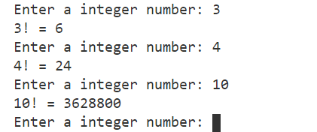
Example
factorial(3)
3 * factorial(2)
2 * factorial(1)
Recursive function:
def factorial(n): # Calculate the factorial value
if n == 1:
return 1
else:
return n * factorial(n-1)
while 1:
n = int(input(‘Enter a positive integer: '))
print(str(n) + '! = ' + str(factorial(n)))
Return 6
Return 2
Return 1

Slide 15
Source
References:
https://docs.python.org/3/library/functions.html
https://docs.python.org/3/reference/datamodel.html
Python 深入淺出程式設計

Slide 16
Exercise 1
Write a Python function that will repeatedly ask the user to input a positive number N, until the inputted value is not positive. When N is inputted, print a list whose elements are square of numbers between 1 and N (include 1 and N).
Input:
20
0
Output:
[1, 4, 9, 16, 25, 36, 49, 64, 81, 100, 121, 144, 169, 196, 225, 256, 289, 324, 361, 400]
bye

Slide 17
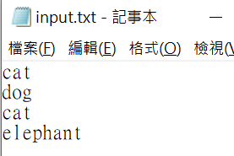
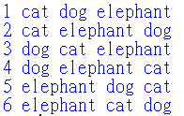
Exercise 2
Write a program that will load data from input.txt and list all permutations for the unique data in input.txt
Input: Output:

